Slide 1
Book Recommendation System Mini Project
Team Details:
Anish S (PES2UG19CS045)
Tankala Sunaina (PES2UG19CS427)

Slide 2


Slide 3

Problem Statement
Recommender systems are software applications that help users to find items of interest in situations of information overload. Book recommender systems particularly targets books as objects of recommendation to readers. We are creating a
book recommender system to understand and analyze the different kinds of recommender systems.

Slide 4

Abstract
We are going to run our association analysis algorithms which will consist of data analyzing techniques like cosine similarity and Pearson Correlation through the obtained dataset(s), with user input of the book he/she has read and find any associative patterns in the database to recommend new books for the user to read. The three models being implemented are: Content Based Cosine Similarity Model, KNN Collaborative Model, Pearson Correlation based Collaborative Model.

Slide 5
problem APPROACH
Our main aim of the project is to recommend books to the user based on the certain input book.
We would then extract an association with the datasets using formulae to group people with similar taste (association analysis).
The datasets would undergo processing like data cleaning and data wrangling before ML algorithms are implemented.
A Collaborative filtering approach and Content based approach has been used for the recommender system.
We would be using machine learning algorithms like cosine similarity matrix and Pearson Correlation to find the pattern of the books read.
TF-IDF (term frequency-inverse document frequency) is used to for vectorizing the similar books.
A detailed case study like report will be made on this project and all the recommender models that we have implemented.

Slide 6
Methodology
Content based approach :
Data cleaning : Removal of unwanted data, unnecessary data, dropping duplicates
Data visualisation : Top rated books, Most popular books, Top popular authors(based on rating, based on number of books published) – bar charts, word clouds
Author based recommendation : TF-IDF matrix calculation , linear kernel
Content based recommendation : CountVectorizer , cosine similarity matrix
Pairwise similarity scores listed and topmost are recommended.

Slide 7
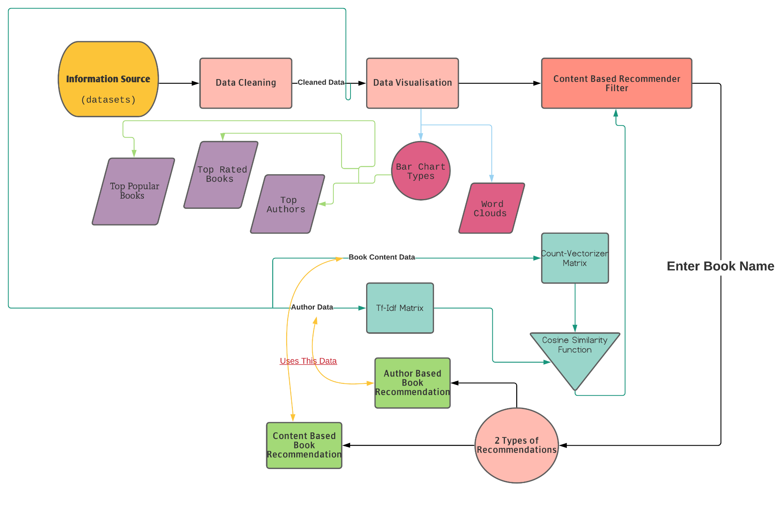
Data-Flow Diagram:

Slide 8
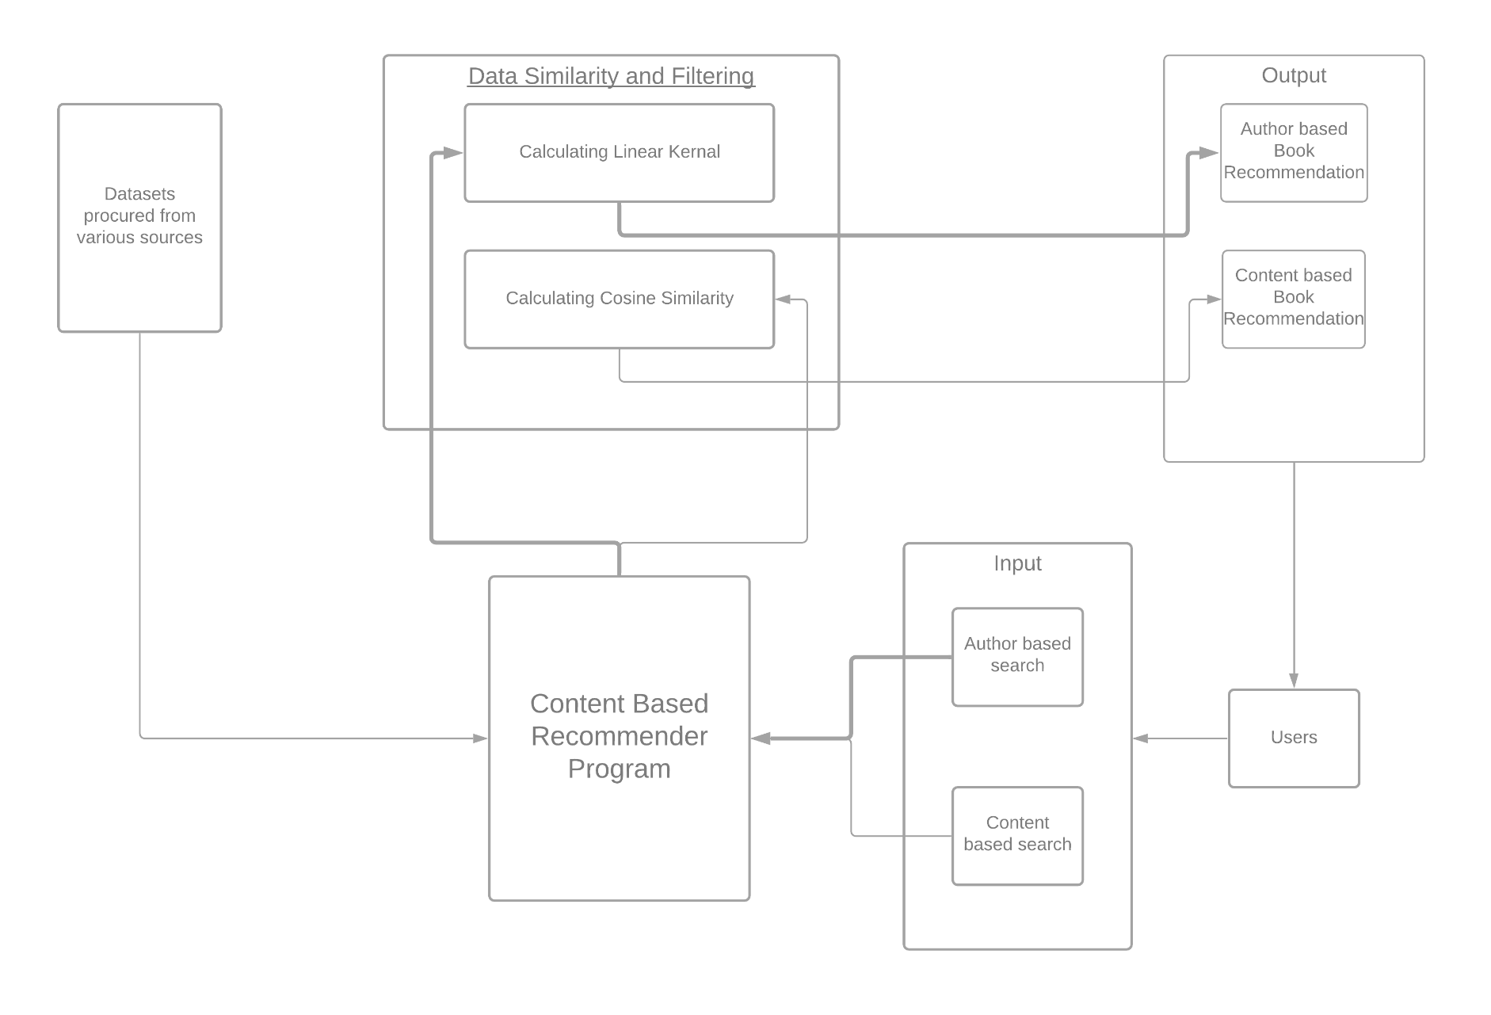
Content based System Architecture:

Slide 9
Methodology
Collaborative filtering approach(KNN) :
Data cleaning : Removal of unwanted data, unnecessary data, dropping duplicates, cleaning text
Creating a single data Frame with required fields
Pivoting the data into a book title × User Id matrix
Transforming to scipy sparse matrix
Training the KNN model : Brute-force approach, cosine metric
Calculating the distance between the rating vectors between book and users in the form of a 2D matrix
Testing the model : Lesser the distance more like minded the two users are

Slide 10
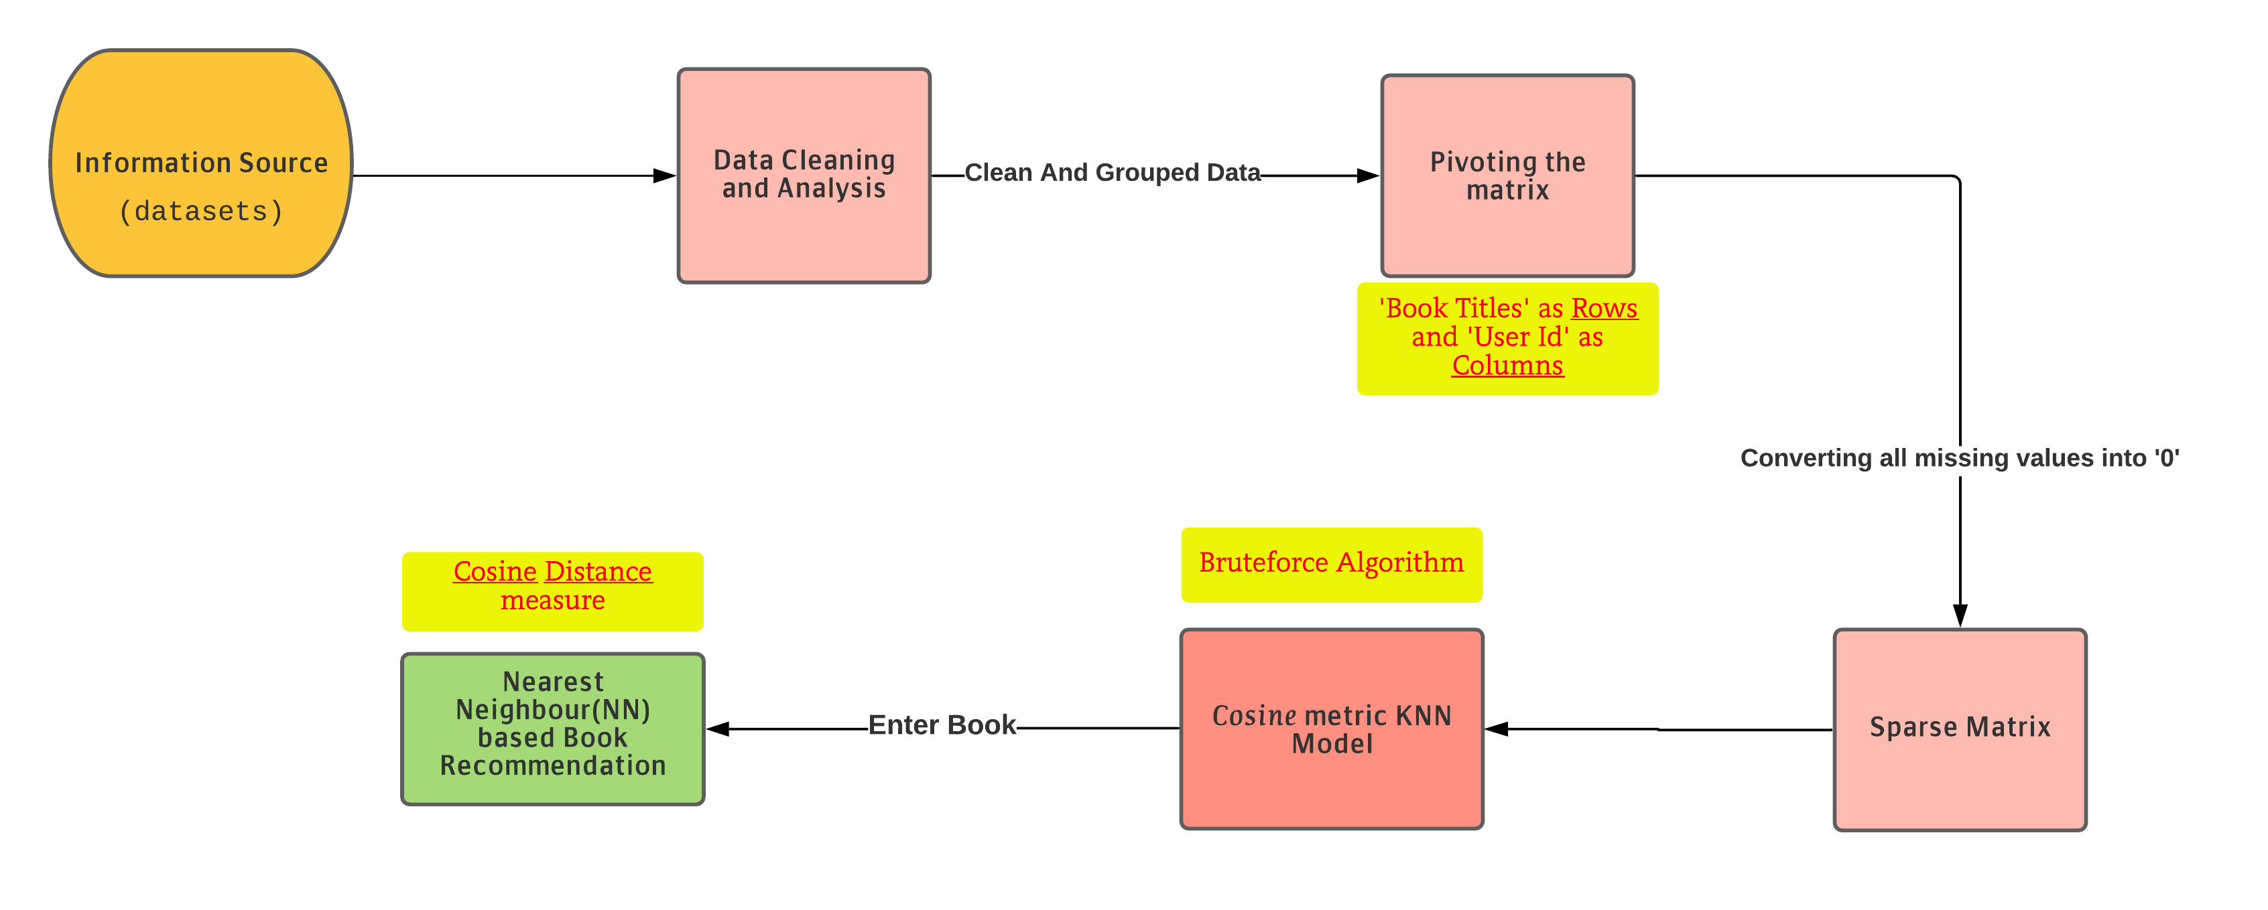
Data-Flow Diagram(KNN):

Slide 11
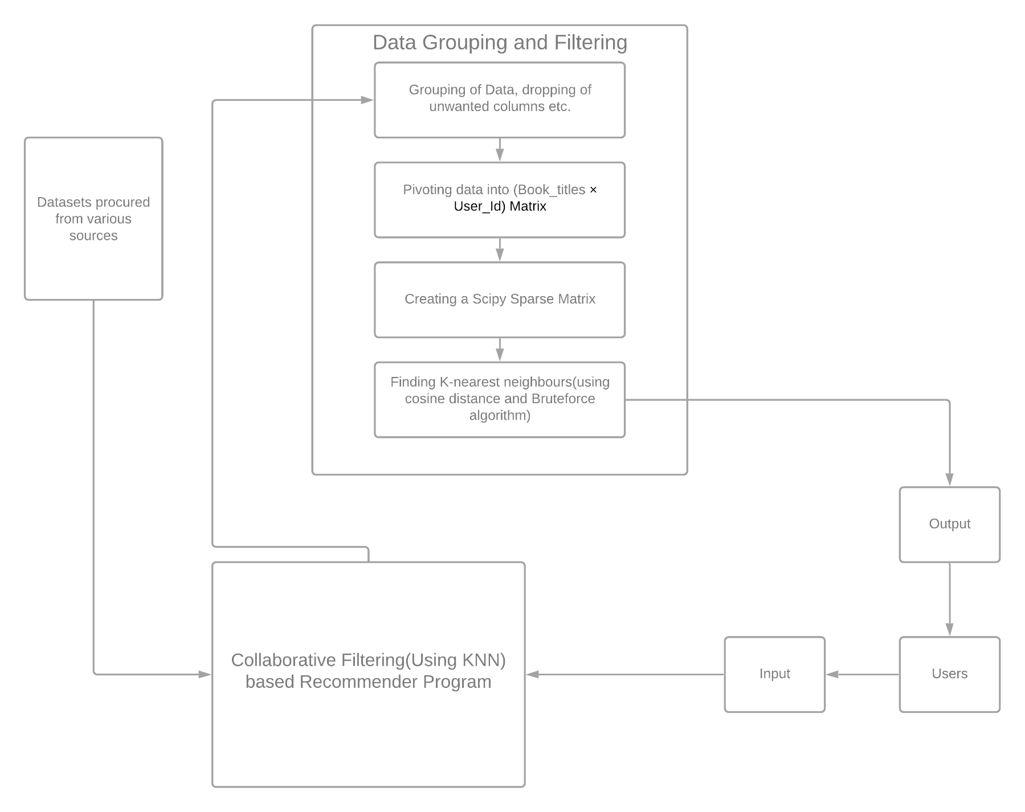
Collaborative based(KNN) System Architecture:

Slide 12
Methodology
Collaborative Filtering approach(Pearson):
Basic data cleaning(removing unwanted data and dropping useless columns)
Creating a single data frame with req. fields
Creating a Pivot table(User ID × ISBN)
Finding the Pearson Correlation b/w a specified book and rest of the books in the dataset
The higher the correlation value the more similar is the chance of the user liking the recommended book.

Slide 13
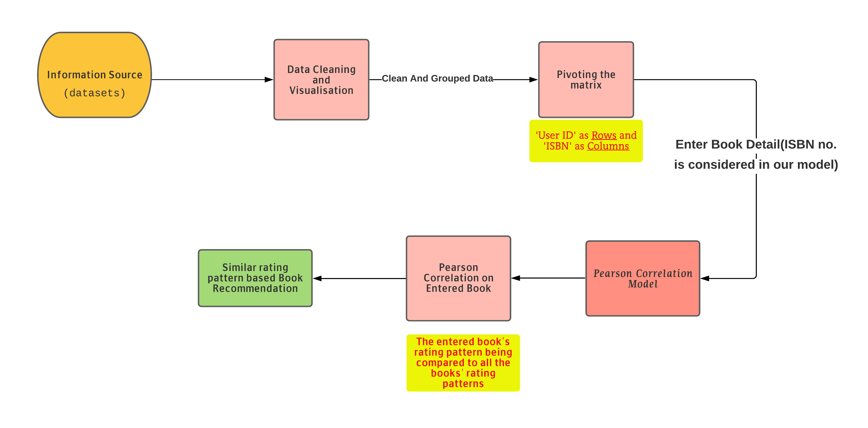
Data-Flow Diagram(Pearson):

Slide 14
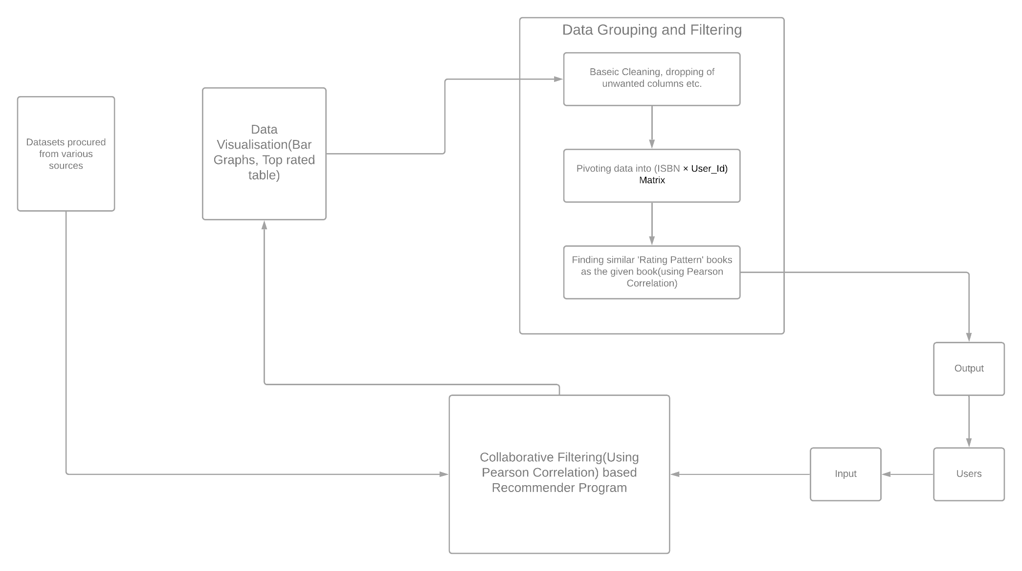
Collaborative based(Pearson) System Architecture:

Slide 15
MODULES And Fuctions
Python modules used:
numpy : linear algebra, data visualization (finding threshold)
pandas : data processing
plotly : data visualization
cufflinks : connects the pandas data frame with plotly enabling users to create visualizations directly from Pandas
matplotlib : display wordcloud
wordcloud : data visualization technique used for representing text data in which the size of each word indicates its frequency

Slide 16
scipy : used for importing csr_matrix
sklearn : importing NearestNeighbors
Some Important functions:
TfidfVectorizer : calculates the tfidf score
linear_kernel : computes the degree-1 kernel between two vectors which represents the similarity between them
CountVectorizer : convert a collection of text documents to a vector of term/token counts
cosine_similarity : measure of similarity between two non-zero vectors of an inner product space that measures the cosine of the angle between them
csr_matrix : creates a sparse matrix of ratings for efficient classification
NearestNeighbours : filters the nearest neighbors of the like-minded users

Slide 17
Expected Result
We will create recommender models where users can input/update the books they have read which will help us suggest new books for the users to venture and read.
The process of making these models will help us learn new concepts in areas like ML, Stastistics etc.
Ultimately we will create three book recommender models and a detailed report of the same venture.

Slide 18
THANK YOU

